Slide 1

FRAUD DETECTION AND
PREVENTION ENHANCEMENTS

Slide 2
SCOPE OF THE PROJECT
The project aimed to enhance ZendNow’s fraud detection and prevention capabilities by integrating advanced machine learning models, customizable fraud rules, and an intuitive dashboard for monitoring flagged transactions. The solution needed to seamlessly integrate into ZendNow’s existing payment infrastructure while maintaining processing speed and adaptability to diverse merchant needs. Key objectives included minimizing revenue loss due to fraud, improving detection accuracy, and empowering merchants with greater control over fraud prevention.

Slide 3
THE CHALLENGE
ZendNow’s existing fraud detection system faced high false positive rates, leading to
unnecessary disruptions and lost revenue for merchants. Merchants lacked the ability to tailor
fraud prevention settings to their specific business needs, limiting their control over risk
management. Additionally, the platform struggled to keep pace with increasingly sophisticated
fraud tactics and varied risk profiles across regions and industries. The challenge was to deliver
a scalable, user-friendly solution that balanced robust fraud detection with minimal friction for
legitimate transactions.

Slide 4
PHASE 1: DISCOVERY AND PROBLEM DEFINITION
Goal: Understand the scope of the fraud problem and define clear objectives for the project.
1. Stakeholder Interviews:
Engaged merchants, customer success teams, and internal risk experts to understand the pain points related to fraud and chargebacks.
Outcome: Identified major challenges, including high false positives in fraud detection and insufficient customizability for merchants.
2. Data Analysis:
Analyzed historical transaction data to quantify the scale of fraud, types of fraud patterns, and associated financial losses.
Outcome: Determined that 20% of flagged transactions were false positives, leading to lost revenue for merchants.
3. Benchmarking:
Conducted a competitive analysis of fraud prevention tools in the market to identify gaps in SendNow’s offering.
Outcome: Found that competitors offered more advanced fraud rules and better user control.

Slide 5
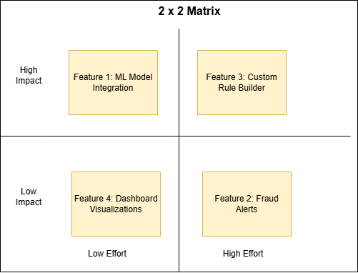
PHASE 2: SOLUTION DESIGN AND PLANNING
Goal: Define the approach for building enhanced fraud detection and prevention features.
Feature Ideation:
Collaborated with data science, engineering, and product design teams to brainstorm solutions. Proposed key features:
Machine learning (ML) models for real-time fraud detection.
Customizable fraud rules for merchants.
Intuitive dashboards to monitor flagged transactions.
Outcome: Prioritized an MVP focusing on ML-based detection and customizable rules.

Slide 6
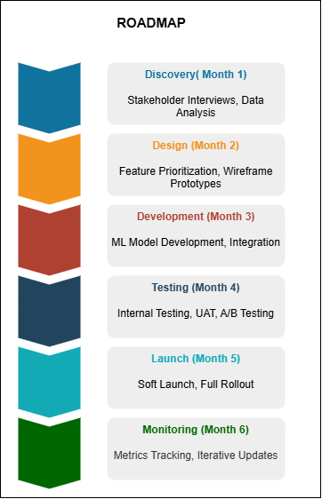
PHASE 2: SOLUTION DESIGN AND PLANNING
2. Roadmap Development:
Created a roadmap detailing milestones, deliverables, and timelines for feature development and rollout.
Outcome: Secured buy-in from stakeholders and aligned the team on a phased delivery approach.

Slide 7
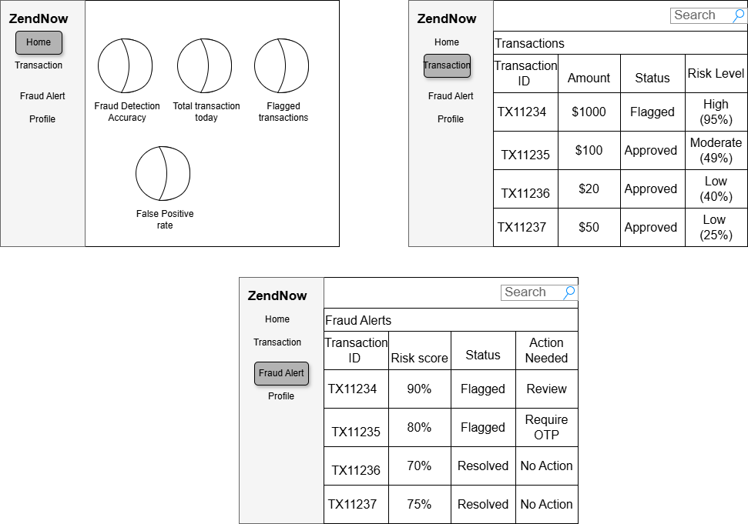
PHASE 2: SOLUTION DESIGN AND PLANNING
3. User Story Development:
Drafted detailed user stories and acceptance criteria for each feature.
Example: “As a merchant, I want to set custom fraud rules so I can align fraud prevention with my business risk tolerance.”

Slide 8
PHASE 3: DEVELOPMENT AND INTEGRATION
Goal: Build and integrate fraud prevention features into the ZendNow platform.
Machine Learning Model Development:
Worked with data scientists to train ML models using historical transaction data, incorporating features like transaction frequency, geolocation, and user behavior.
Outcome: Developed a model that flagged transactions with 40% greater accuracy than the previous system.
2. Custom Fraud Rules:
Partnered with engineers to create a rule builder interface that allowed merchants to define custom thresholds for fraud detection.
Outcome: Delivered a user-friendly tool enabling merchants to adjust fraud sensitivity based on their specific needs.
3. Backend Integration:
Integrated the ML model and fraud rule system into ZendNow’s payment processing pipeline, ensuring seamless operation.
Outcome: Achieved real-time fraud detection without impacting transaction processing speed.

Slide 9
PHASE 4: TESTING AND VALIDATION
Goal: Ensure the system performs accurately and meets user needs.
1. Internal Testing:
Conducted stress tests to validate the ML model’s performance under high transaction volumes.
Outcome: Verified the system could handle peak loads without performance degradation.
2. User Acceptance Testing (UAT):
Collaborated with selected merchants to pilot the new fraud prevention tools and gather feedback.
Outcome: Identified minor usability issues in the rule builder, which were resolved before the full launch.
3. A/B Testing:
Compared the new fraud detection system with the old one using a subset of transactions.
Metrics evaluated: fraud detection accuracy, false positive rate, and processing speed.
Outcome: Demonstrated a 25% reduction in false positives and a 40% improvement in fraud detection accuracy.

Slide 10
PHASE 5: LAUNCH AND ROLLOUT
Goal: Deploy the enhanced features to all merchants.
1. Soft Launch:
Rolled out the new system to a limited group of merchants for final validation.
Outcome: Collected additional feedback, ensuring a smooth experience for broader adoption.
2. Full Deployment:
Released the fraud detection enhancements across the platform, accompanied by training materials and webinars for merchants.
Outcome: High adoption rates among merchants and positive initial feedback.

Slide 11
PHASE 6: POST-LAUNCH MONITORING AND CONTINUOUS IMPROVEMENT
Goal: Monitor performance and continuously improve the system.
1. Performance Monitoring:
Set up dashboards to track key metrics, including fraud detection accuracy, chargeback rates, and merchant satisfaction.
Outcome: Maintained high performance and identified opportunities for further refinement.
2. Feedback Collection:
Established regular touchpoints with merchants to gather feedback on the new tools and identify feature requests.
Outcome: Initiated plans to add advanced fraud visualization tools based on merchant suggestions.
3. Iterative Enhancements:
Continued to update the ML model with new transaction data and refined the rule builder’s functionality.
Outcome: Ensured the system remained effective against evolving fraud tactics.

Slide 12
KEY RESULTS
40% Improvement in fraud detection accuracy.
25% Reduction in false positives, saving merchants millions in lost revenue.
95% Satisfaction Score for the fraud prevention tools.

Slide 13
THANK
YOU

